Slide 1
Brain Tumor Classification Using Deep Learning

Slide 2
Introduction
Brain tumors are aggressive diseases, accounting for 85-90% of CNS tumors, requiring early and accurate detection.
MRI scans are the best method for detection, but manual analysis is time-consuming and prone to errors.
Deep Learning techniques like CNN, ANN, and Transfer Learning improve classification accuracy.
The system classifies tumors into Glioma, Meningioma, Pituitary Tumor, and No Tumor categories.
An automated cloud-based system can assist doctors, especially in regions lacking skilled professionals.

Slide 3
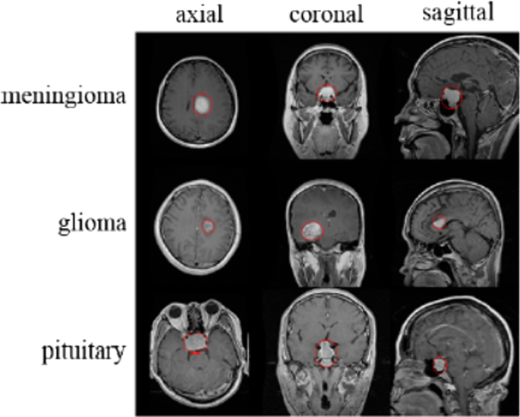
Problem Statement
Manual MRI analysis is time-consuming, error-prone, and requires skilled radiologists.
Lack of expertise and resources in developing regions delays accurate diagnosis.
An automated Deep Learning system can improve accuracy and speed up diagnosis.
The system classifies tumors into Glioma, Meningioma, Pituitary Tumor, and No Tumor.
Uses CNN, ANN, and Transfer Learning to assist medical professionals in tumor identification.

Slide 4
Objectives
Develop an automated system for brain tumor detection and classification using Deep Learning.
Enhance diagnostic accuracy by leveraging CNN, ANN, and Transfer Learning models.
Classify brain tumors into four categories: Glioma, Meningioma, Pituitary Tumor, and No Tumor using MRI scans.
Reduce dependency on manual analysis and assist radiologists in faster and more precise diagnosis.
Implement a cloud-based solution for easy accessibility, especially in regions with limited medical expertise.

Slide 5
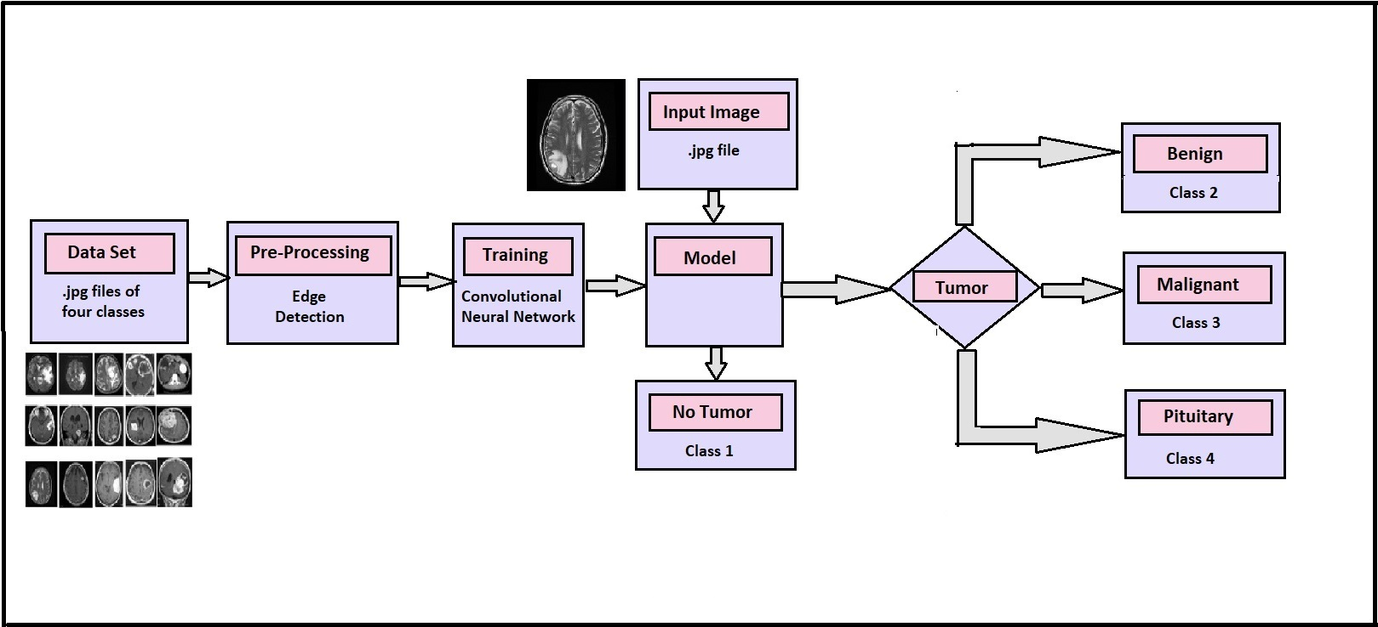
Architecture Diagram:

Slide 6
Procedure: Using CNN
Collect and preprocess MRI scans (resize, normalize, and apply data augmentation).
Design a CNN model with convolutional, pooling, and fully connected layers.
Train the model using labeled MRI images with categorical cross-entropy loss.
Evaluate performance using accuracy, precision, recall, and confusion matrices.
Deploy the model for real-time tumor detection via a cloud or desktop application.

Slide 7
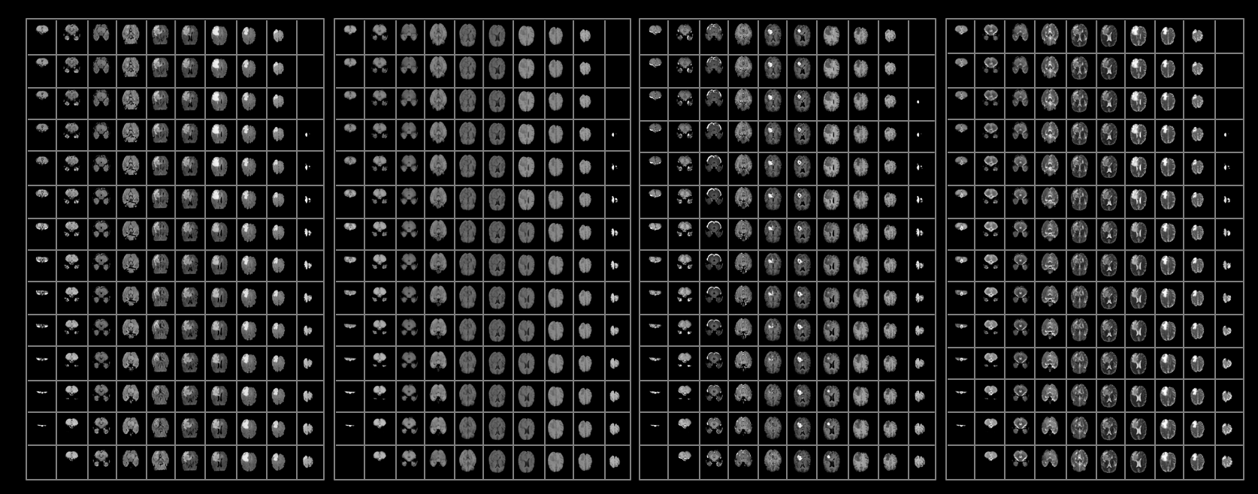
2. Segregate data into classes.

Slide 8
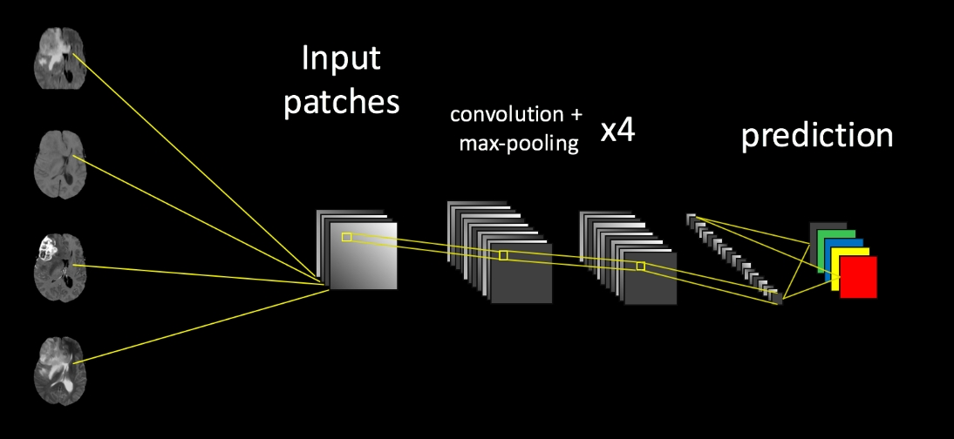
Building the network

Slide 9
Future Scope
Improved Diagnostics.
Covering more number of classes of Brain Tumor.
Accurate Growth Rate Prediction of Tumor.
Reduction in Medical Negligence.

Slide 10
References
http://biomedpharmajournal.org/vol11no3/brain-tumor-classification-using-convolutional-neural-networks/
https://www.nitrc.org/projects/ibsr/
https://figshare.com/articles/brain_tumor_dataset/1512427
Brain Tumor Classification Using Convolutional Neural Networks J. Seetha1 and S. Selvakumar Raja2
https://github.com/Swati707/brain-tumor-classification/blob/master/PresentationAppendix.docx

Slide 11
THANK YOU

